Slide 1
PIZZA SALES ANALYSIS
Maximizing Pizza Sales with Analytics
Project owner : Devanshi Thakkar

Slide 2
Content
01
Background
02
Problem Statement
03
Recommended Analysis
04
Conclusion

Slide 3


01
Background
This report provides an overview of pizza sales data from January 2015 to December 2015. Data was collected from various pizza joints across the United States and analyzed to uncover trends and patterns in pizza sales.
02
Problem Statement
The pizza restaurant has recently experienced a decline in sales and aims to boost them by examining customer and order data. Management plans to conduct a thorough analysis of order data and consumer behavior to identify key trends and areas for improvement.

Slide 4
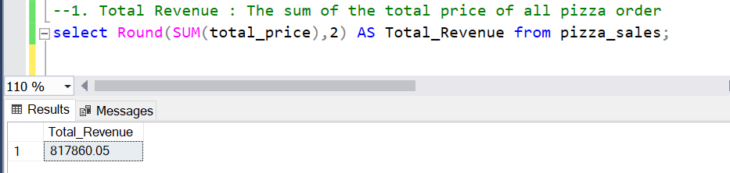
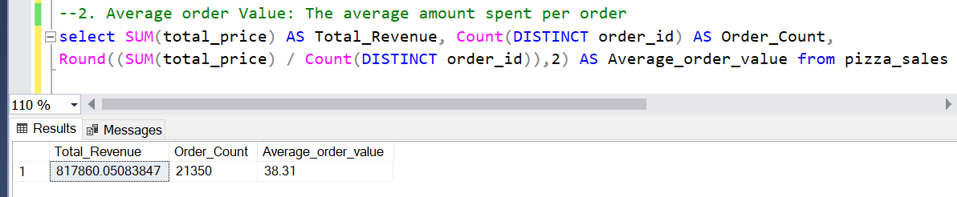
Recommended Analysis : KPI’s
1. The sum of the total price of all orders
2. The average amount spend per order

Slide 5
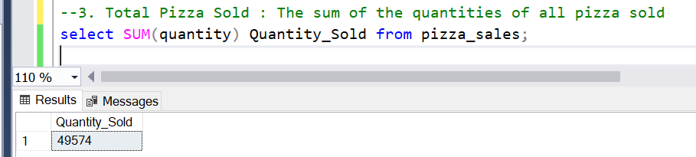
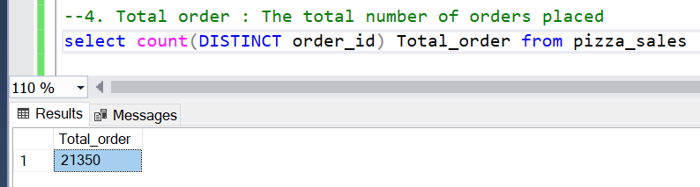
Recommended Analysis : KPI’s
3. The sum of the quantities of all pizza sold.
4. The total number of order placed.

Slide 6
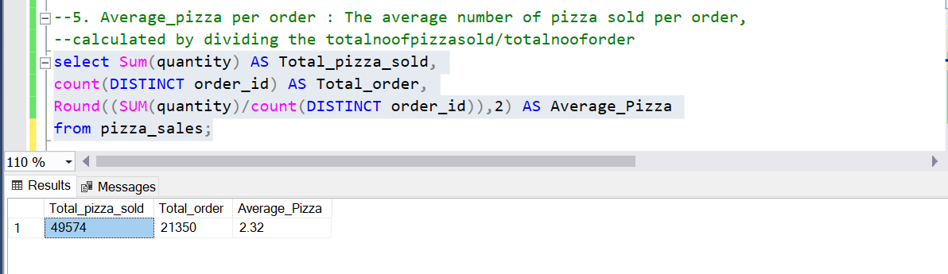
Recommended Analysis : KPI’s
5. The Average number of pizza sold per order

Slide 7
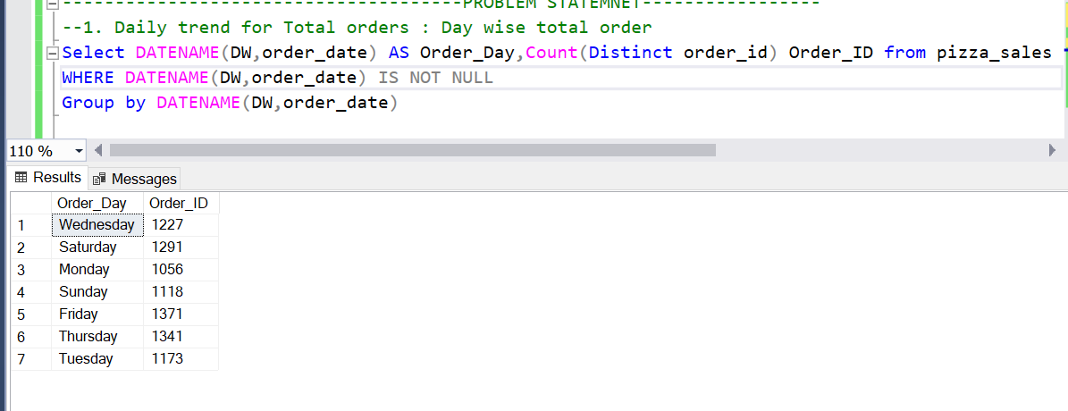
Recommended Analysis : Problem statement
1. Daily trend for total orders : Day wise total order

Slide 8
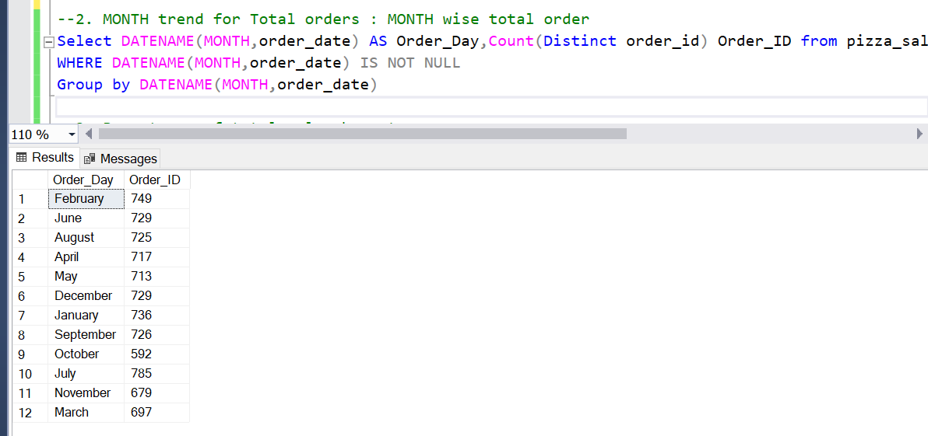
Recommended Analysis : Problem statement
2. Monthly trend for total orders : Month wise total order

Slide 9
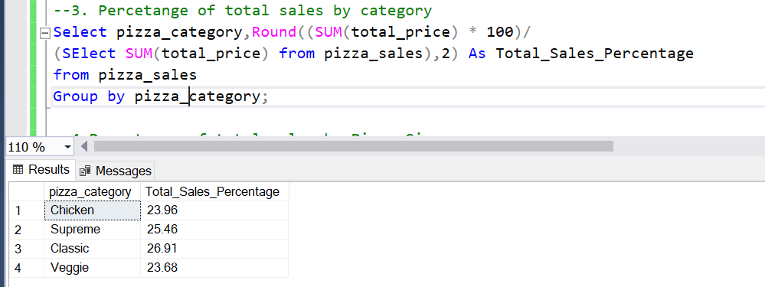
Recommended Analysis : Problem statement
3. Percentage of total sales by category

Slide 10
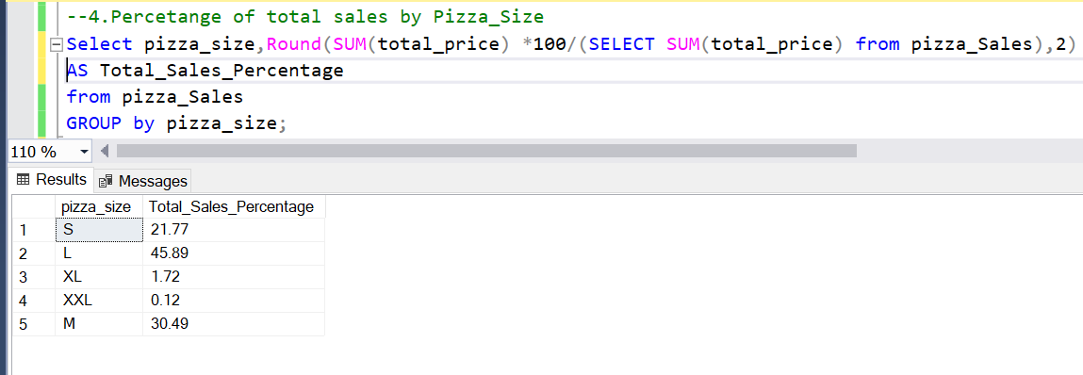
Recommended Analysis : Problem statement
4. Percentage of total sales by pizza size

Slide 11
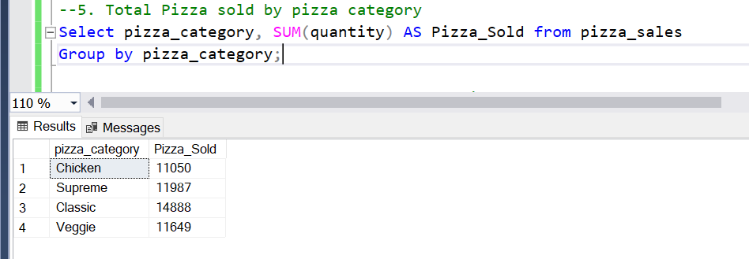
Recommended Analysis : Problem statement
5. Total pizza sold by pizza category

Slide 12
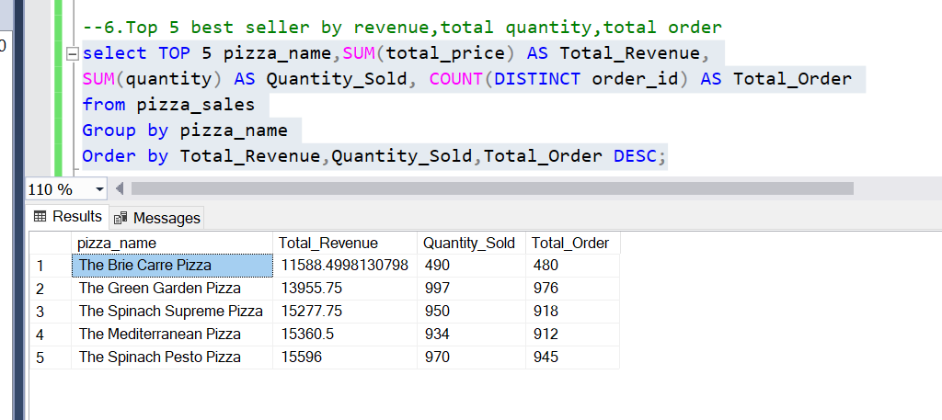
Recommended Analysis : Problem statement
6. Top 5 best seller by revenue,total,quantity, total order

Slide 13
Conclusion
The analysis enabled optimized inventory management by identifying high-demand products and peak sales periods, reducing waste and ensuring stock availability.
Targeted marketing campaigns and informed pricing strategies were developed based on customer behavior insights, leading to increased revenue.
Improved decision-making for promotional strategies enhanced customer satisfaction and loyalty, addressing the recent decline in sales.

Slide 14
THANK YOU
Date : 21 June 2024

